Slide 1
Beyond Burns
Teaching Scots in the English classroom

Slide 2
1. What is Scots?
2. Why teach Scots?
3. Writing in Scots at BGE
4. Reading Scots at Senior Phase
5. SQA Scots Language Award
6. Useful links

Slide 3
What is Scots?
The Scots Language is one of the three indigenous languages of Scotland
Scots and English are considered ‘sister’ languages
There are many different varieties - dialects - of Scots

Slide 4
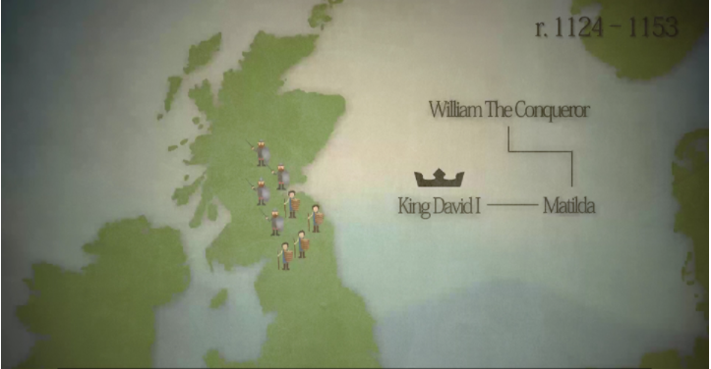
What is Scots?
History of Scots (Education Scotland)
Origins of Scots
(AMC Historical Linguistics)

Slide 5
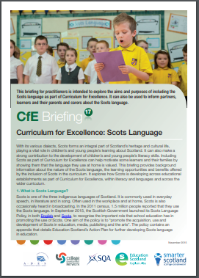
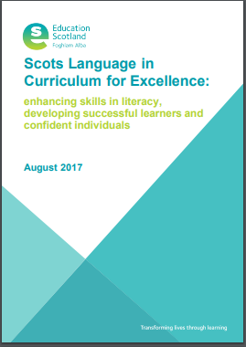
Why teach Scots?
Develops reading strategies and critical literacy skills
Reinforces understanding of structures and features of language
Provides opportunities for IDL
ENGAGEMENT

Slide 6
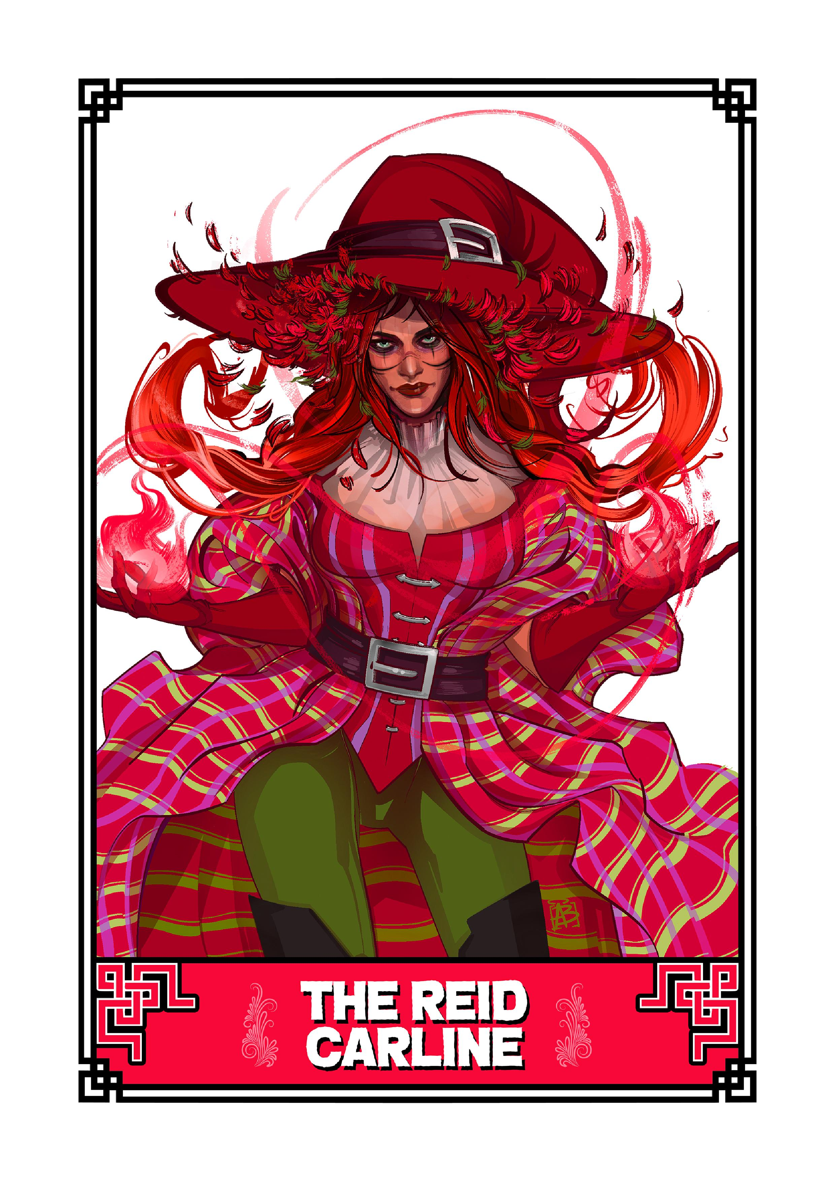
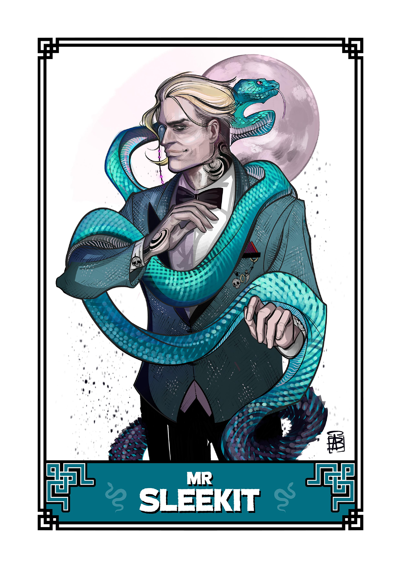
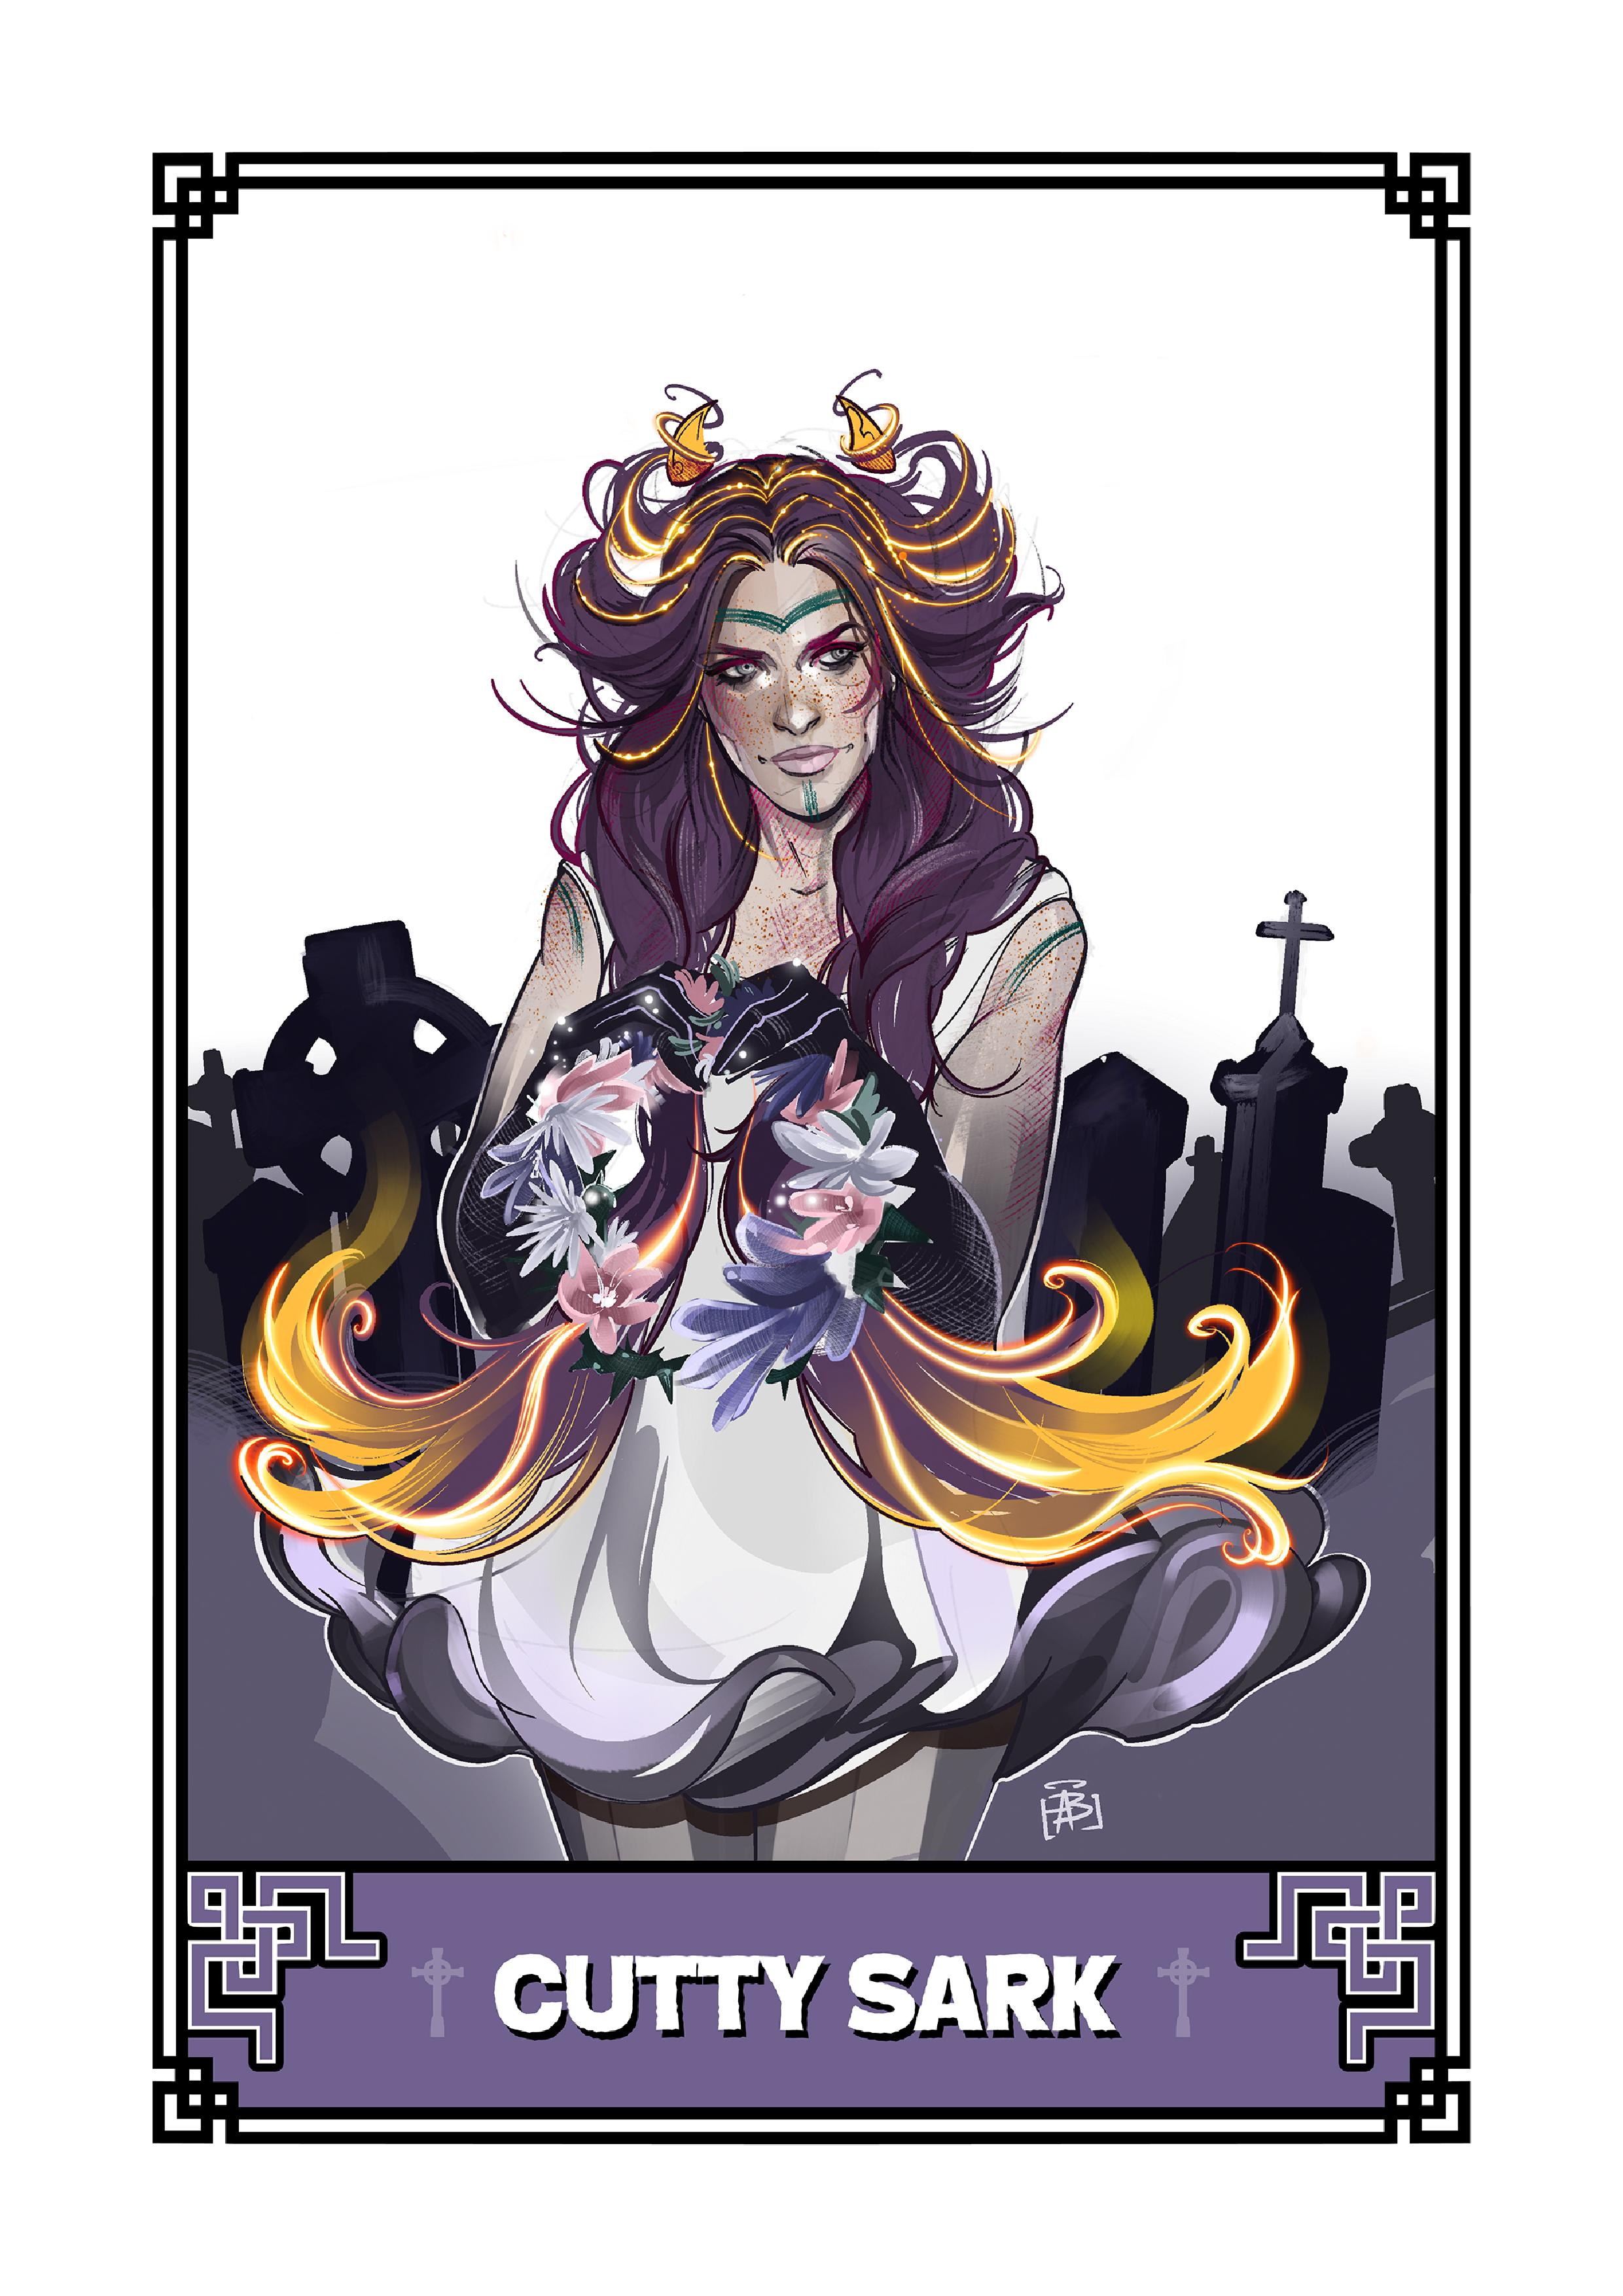
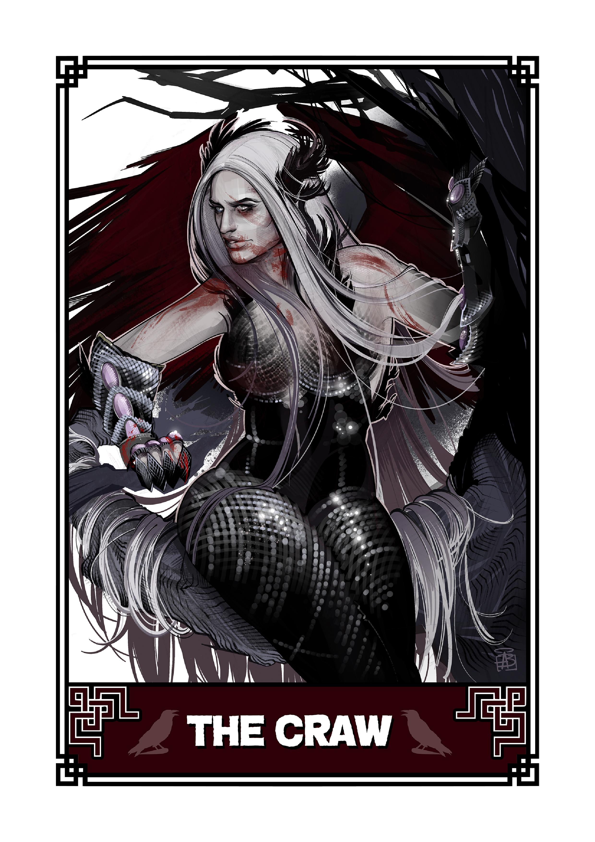
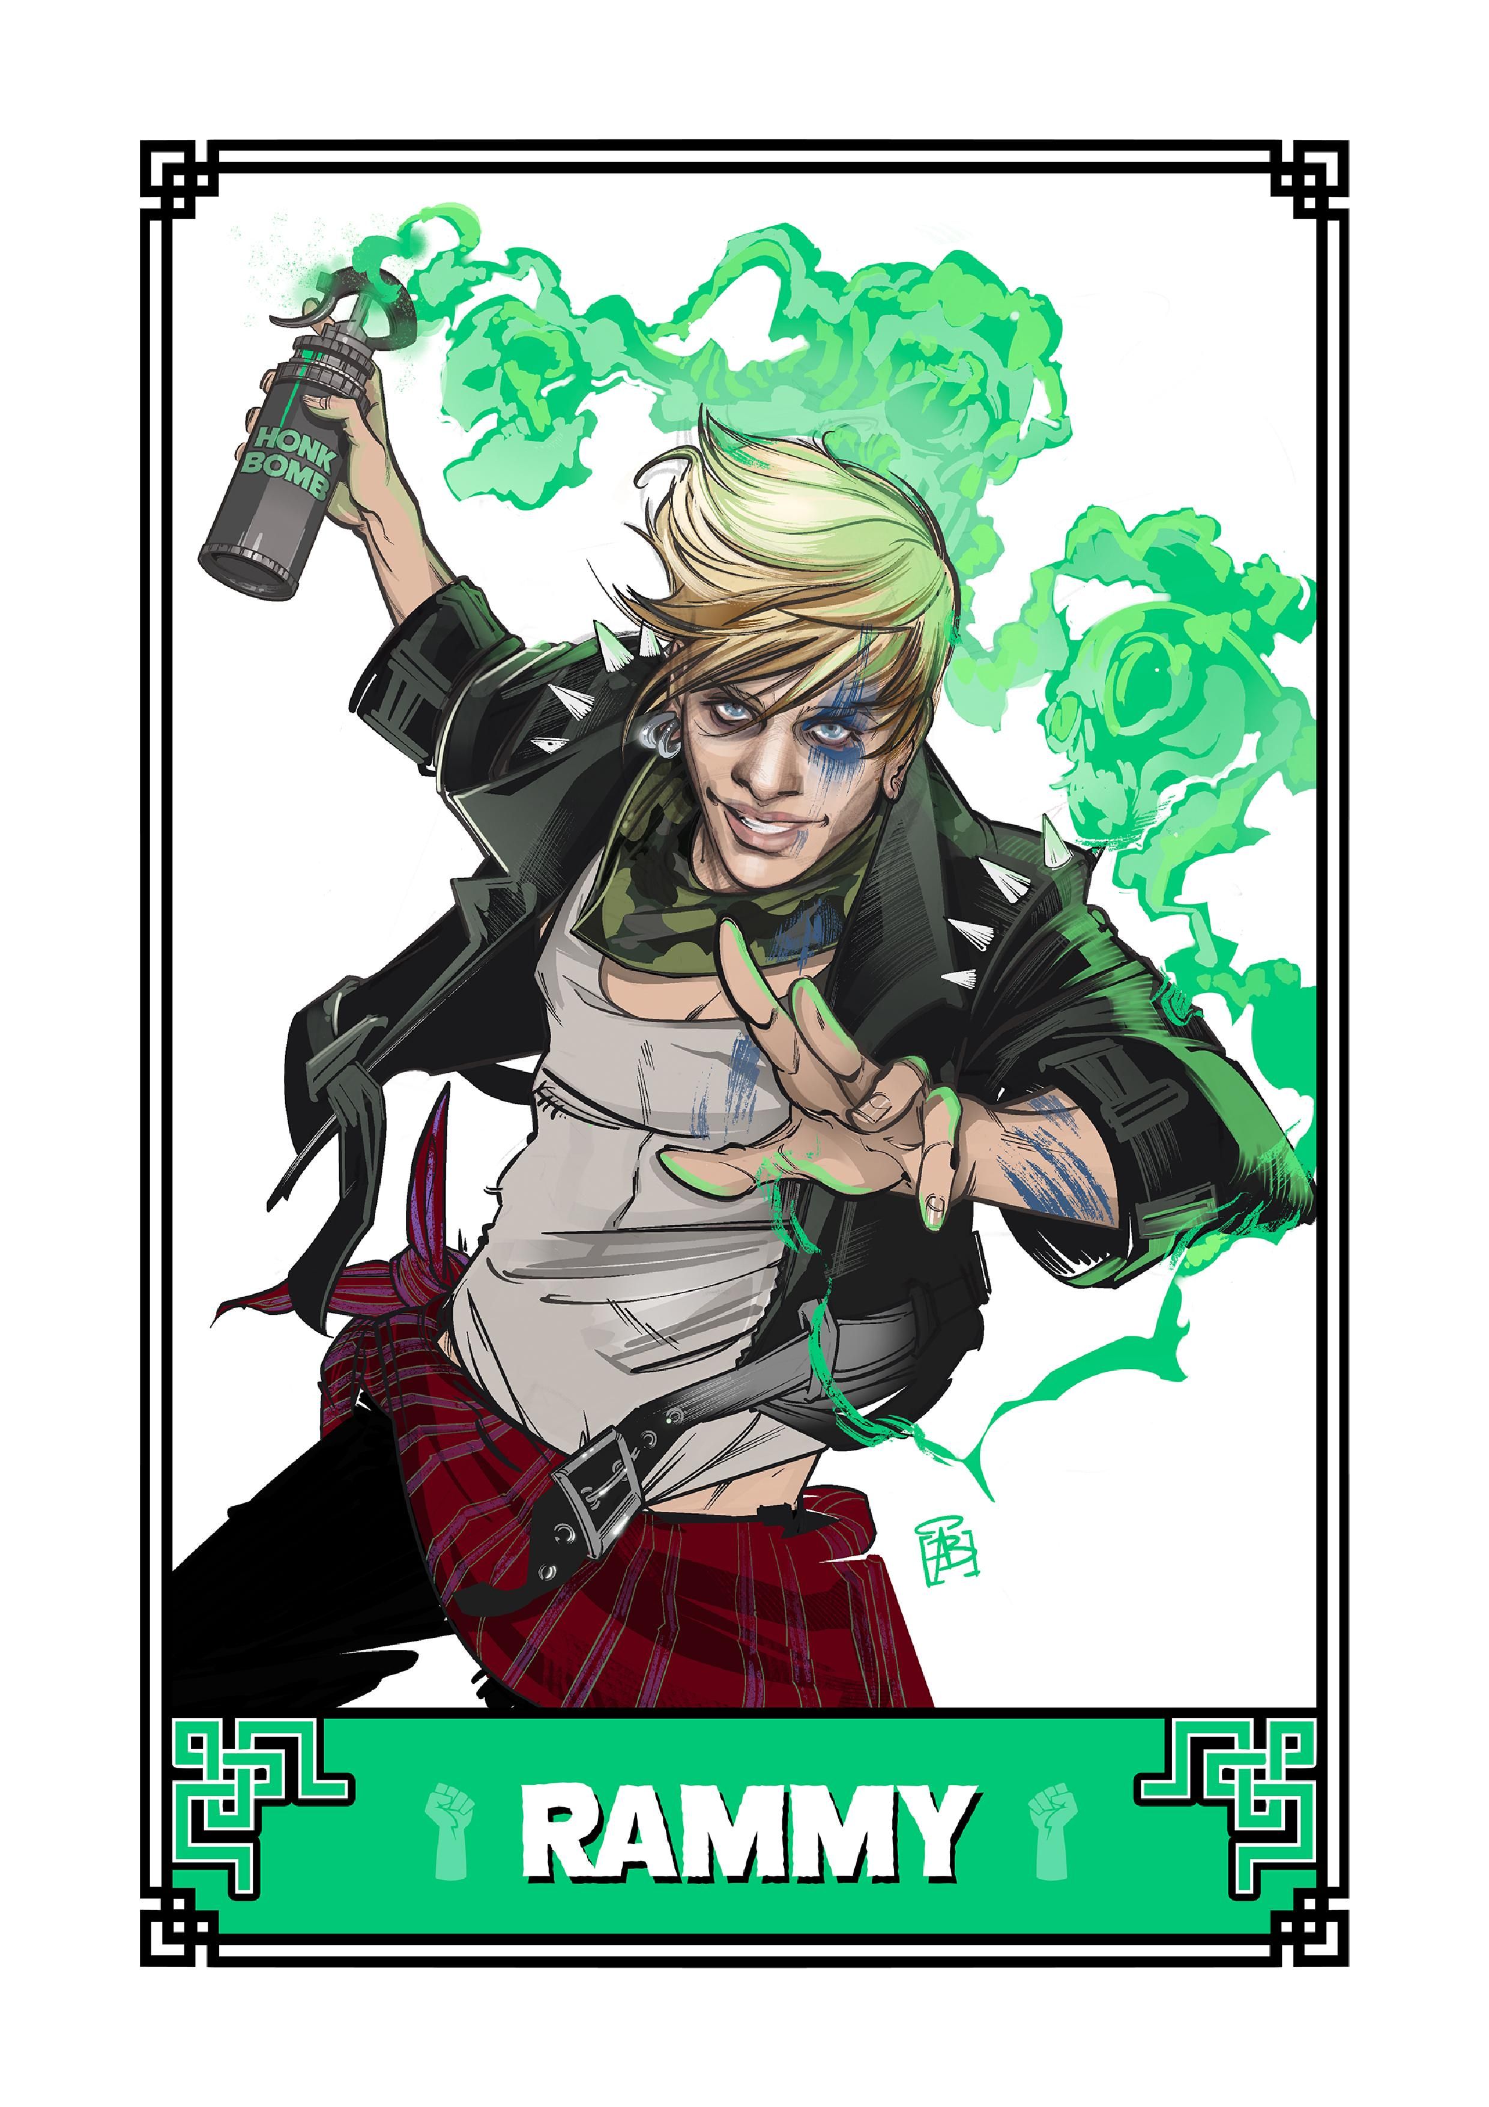
Writing in Scots at BGE

Slide 7
Writing in Scots at BGE
https://www.bbc.co.uk/programmes/p01jqwkp
http://scotsinschools.co.uk/creativity.html
https://education.gov.scot/improvement/learning-resources/100-key-scots-words/

Slide 8
Writing in Scots at BGE
glaikit
glaiket
glakit
glaekit
gleckit
glaykit
glacet

Slide 9
Reading Scots at Senior Phase
Scottish texts in National 5 and Higher English
Sailmaker by Alan Spence (N5)
Tally’s Blood by Anne Marie di Mambro (N5)
The Cheviot, the Stag and the Black, Black Oil by John McGrath (H)
The Slab Boys by John Byrne (H)
Short Stories by Anne Donovan: All that Glisters, Away in a Manger, Dear Santa, Hieroglyphics (N5)
Sunset Song by Lewis Grassic Gibbon (H)
Robert Burns: Holy Willie’s Prayer, Tam O’Shanter, To A Mouse, A Poet’s Welcome to his Love-Begotten Daughter, To a Louse, A Red, Red Rose (H)
Jackie Kay: Old Tongue (N5)
Notes:
It should be noted that, in the 2019 exams, Sailmaker was the second most popular choice of text, and Tally’s Blood the 4th most popular. At Higher, candidates most often choose to answer their ‘Scottish texts’ part of the exam paper using poetry – but Burns is the second least popular option. The Slab Boys is the second most popular drama option.

Slide 10
Reading Scots at Senior Phase
Notes:
Holy Willie’s Prayer game: https://www.scotslanguage.com/learning?activity=5402

Slide 11
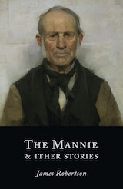
Reading Scots at Senior Phase
Teaching Notes
Jackie Kay poetry
Tally’s Blood
The Cheviot, the Stag and the Black, Black Oil
Burns
The Slab Boys
Notes:
ASLS – Free download of The Mannie: https://asls.arts.gla.ac.uk/Mannie.html

Slide 12
SQA Scots Language Award
History and Development
Can you discuss the factors that influenced the development of Scots?
Can you identify and explain the features of Scots?
Understanding and Communication
Can you show that you can read Scots and understand it?
Can you apply this understanding to your own written Scots?

Slide 13
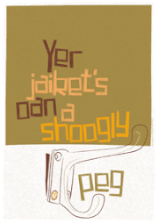
Jist fir fun…

Slide 14
Useful links
https://www.scotslanguage.com/
https://www.scotslanguage.com/learning
https://education.gov.scot/improvement/learning-resources/
http://www.scotsinschools.co.uk/
https://dsl.ac.uk/
https://asls.arts.gla.ac.uk/
https://www.sqa.org.uk/sqa/70056.html
http://bit.ly/scotsblether

